Slide 1


Review Analysis Dashboard v1.1
AI/ML Science Team

Slide 2
Project Goal – Amplify the voice of the Consumer
Allow flexible filtering of data to Gender, End Use, Product Class and Sub-class and Style
Use a Large-Language-Model (LLM) to extract overall Sentiment (Positive, Negative, Neutral)
Use the same model to extract Negative and Positive mentions and put in user-defined Categories
Plot changes in Numeric ratings, Sentiment and Mentions over time
Allow spot check of what customers are saying in their reviews
Use AI to look for trends and anomalies

Slide 3
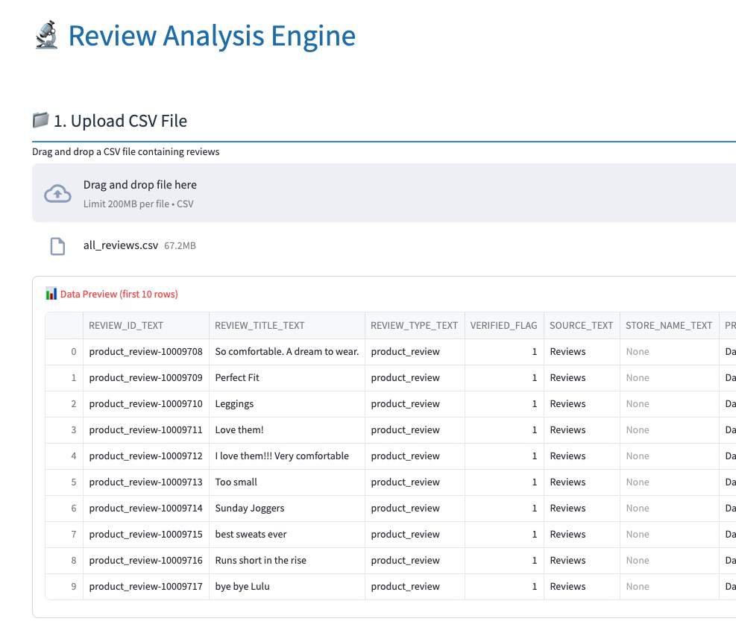
Initial Processing Phase – Load CSV
Review Analysis Engine allows upload of a CSV file with reviews
It assumes the CSV has columns for:
Date
Product Identifier (i.e. SKU)
Numeric Rating
Review Date
Review Text
Review Title (optional)
Notes:
Objective
Focus
Constraints
Applications
Success Metrics

Slide 4
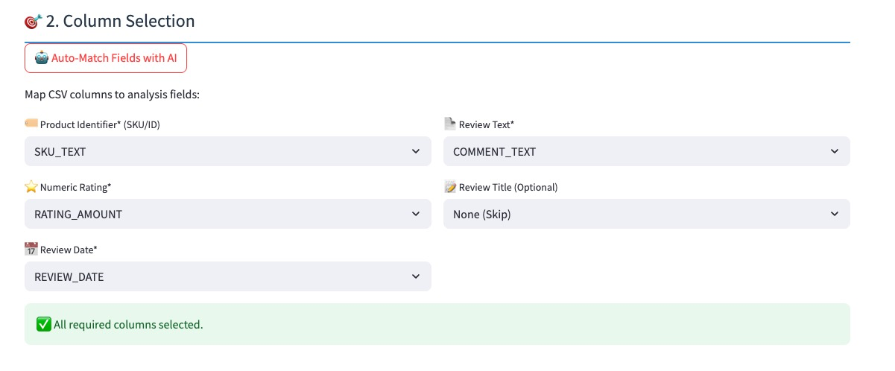
Initial Processing Phase – Mapping CSV Fields
AI is used to make an initial mapping
User can over-ride each mapping
Notes:
Objective
Focus
Constraints
Applications
Success Metrics

Slide 5
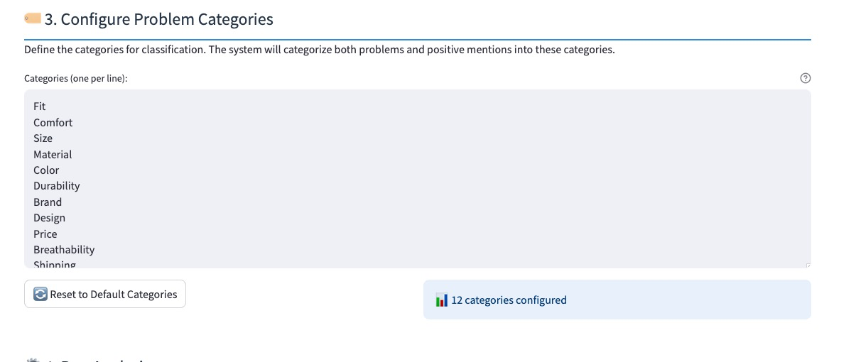
Initial Processing Phase – Problem Categories
User can select what Problem categories they are interested in
Problem categories are arbitrary
Notes:
Objective
Focus
Constraints
Applications
Success Metrics

Slide 6
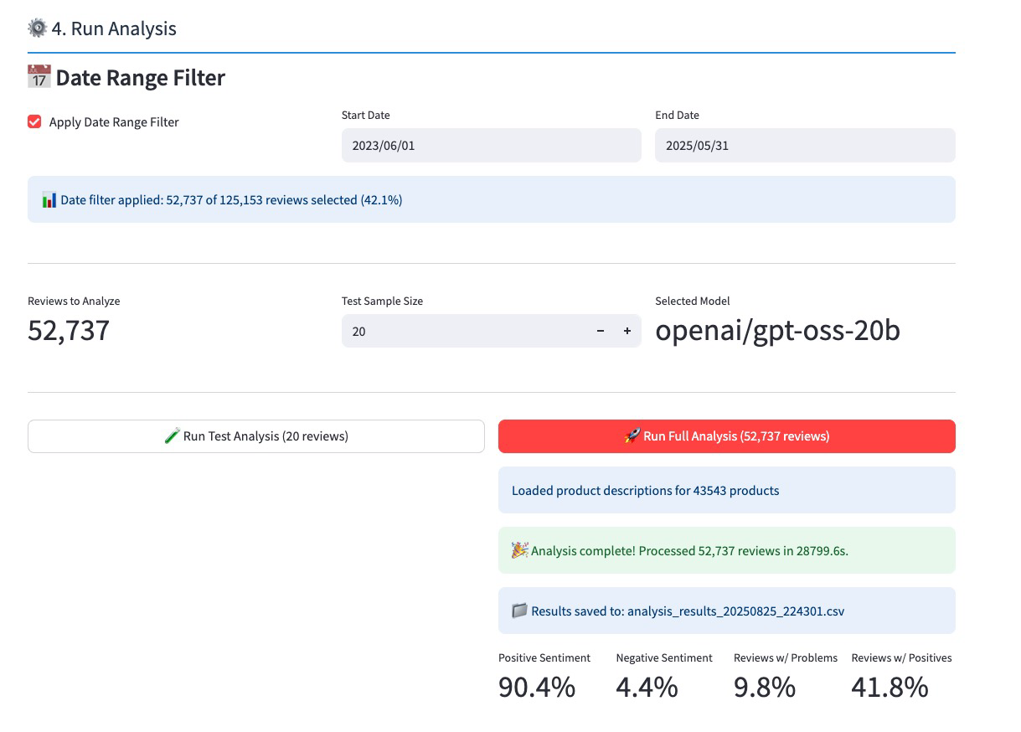
Initial Processing Phase – Process via LLM
User can run a test with a small number rows to make sure all is set up
Date Range filter can cut down the incoming CSV to an appropriate selection
When testing is completed, the user selects “Run Full Analysis”
The analysis runs and the processed input is saved to a CSV; Summar stats are produced
This CSV is input to the analysis dashboard
Notes:
Objective
Focus
Constraints
Applications
Success Metrics

Slide 7
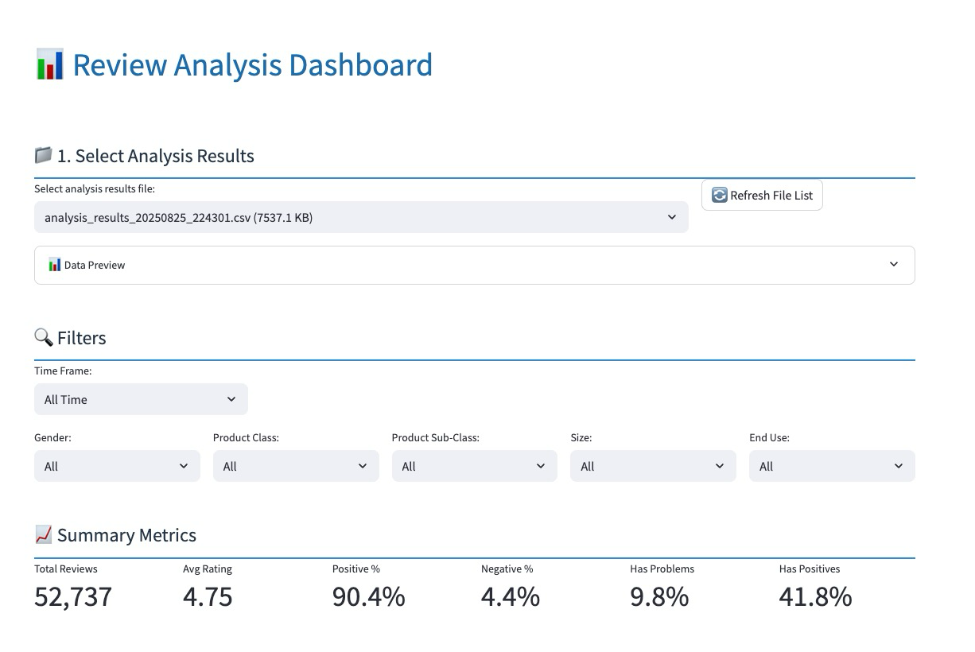
Analysis Dashboard – Process via LLM
User selects a processed file
There’s a data preview dropdown to do a quick check of the data
Filters can be set for Time range, Gender, Class, Sub-Class, Size and End Use
Selecting filters will change the summary metrics so the user gets an idea of how big the data set is after applying filters
Notes:
Objective
Focus
Constraints
Applications
Success Metrics

Slide 8
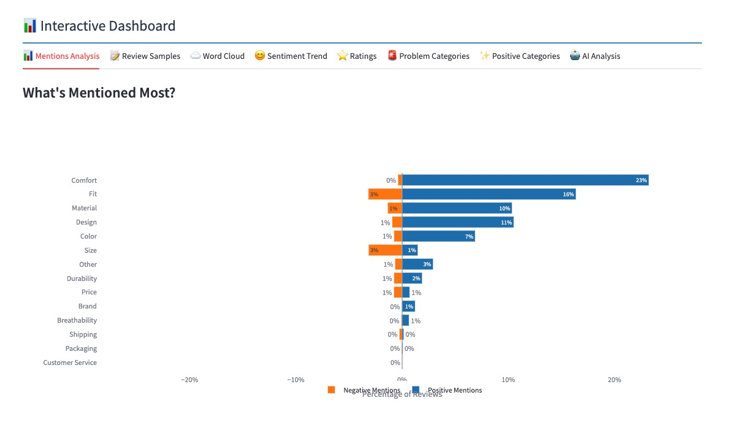
Analytic Panels: Mentions
The categories created during the initial processing are shown with a positive/negative chart by those categories
They are shown in order of most to least “mentions”
Panel respects the filters set at the top of the page

Slide 9
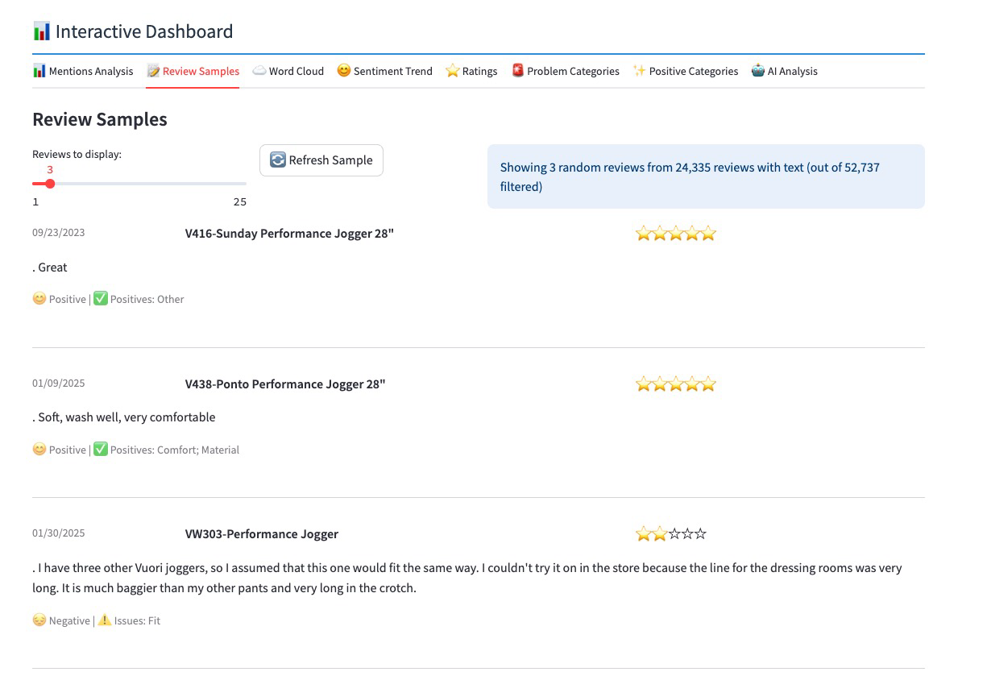
Analytic Panels: Review Samples
This panel allows the user to spot check a random sample of reviews
The product Style & Description are shown along with:
Numeric rating (stars)
Date
Sentiment
Positive Mentions
Negative Mentions
Panel respects the filters set at the top of the page

Slide 10
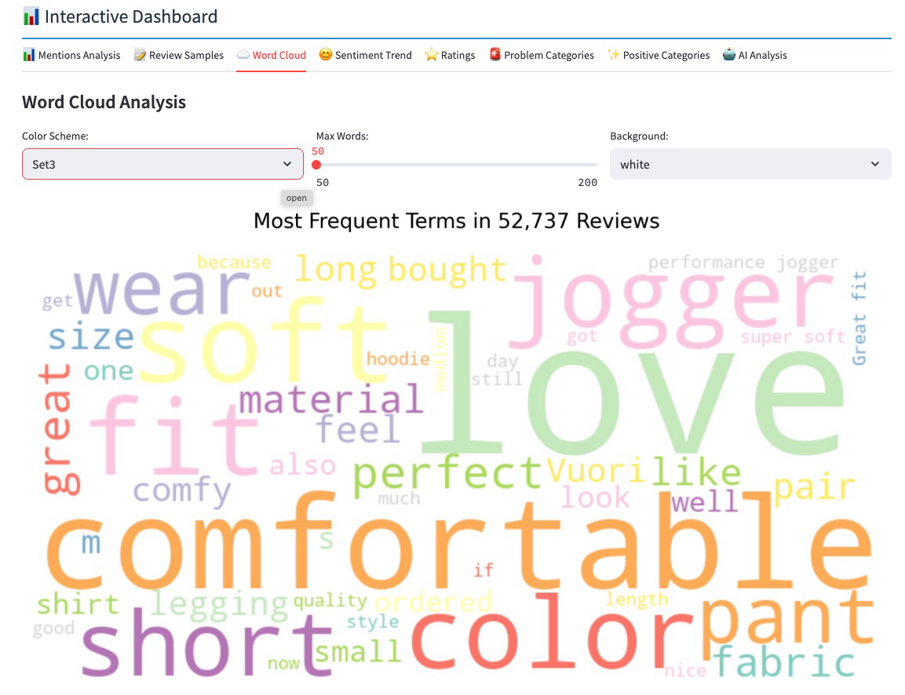
Analytic Panels: Word Cloud
This panel shows the user the relative frequency of words in the review text
The user has some options for displaying different color sets and backgrounds, as well as the maximum number of words shown
Panel respects the filters set at the top of the page

Slide 11
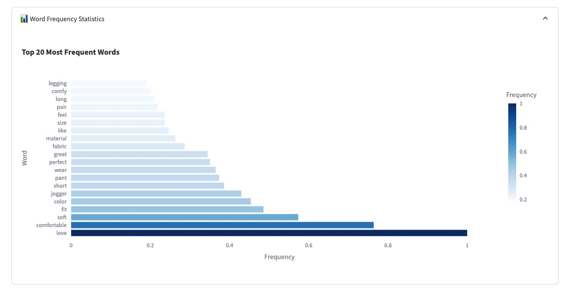
Analytic Panels: Word Frequency
This panel shows the user the top 20 most frequent words in the review text
Panel respects the filters set at the top of the page

Slide 12
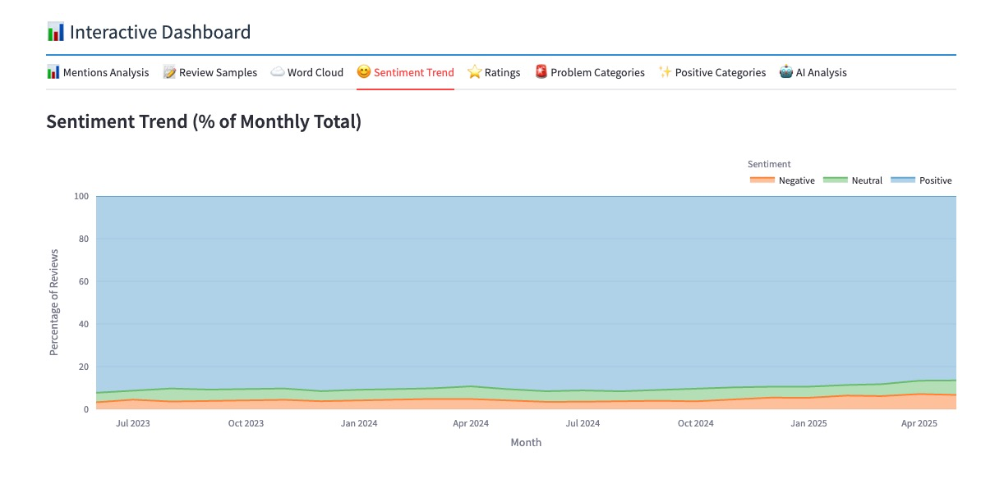
Analytic Panels: Sentiment Trend
This panel shows the user sentiment (positive, neutral, negative) sentiment over the time range selected
All sentiments total to 100% so you can see the relative changes
Panel respects the filters set at the top of the page

Slide 13
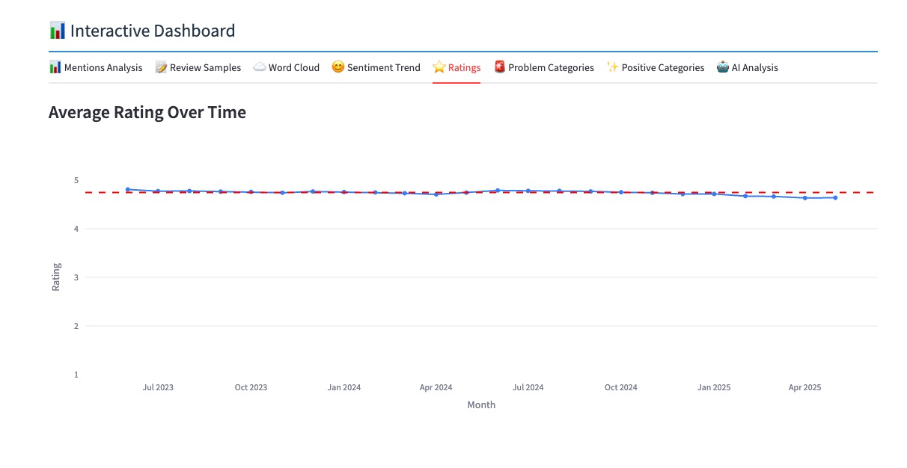
Analytic Panels: Numeric Rating Trend
This panel shows the user the numeric/star ratings over the selected time frame selected
The linear trend is shown on the dotted line
Panel respects the filters set at the top of the page

Slide 14
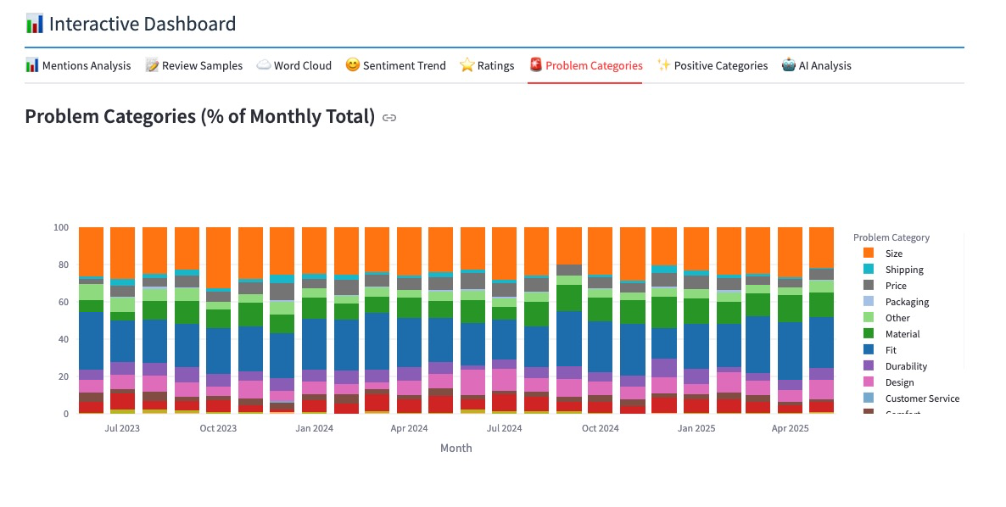
Analytic Panels: Problem Category Trend
This panel shows the user the Problem categories over the time frame selected
The presentation is a stacked bar chart showing the relative percentages of the problems that add up to 100% of the reported problems
Panel respects the filters set at the top of the page

Slide 15
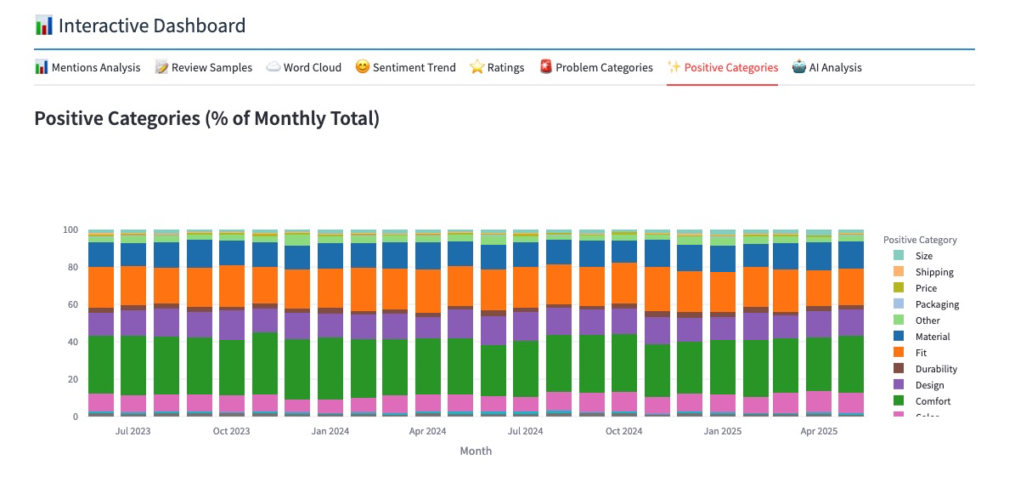
Analytic Panels: Positive Category Trend
This panel shows the user the Positive categories over the time frame selected
The presentation is a stacked bar chart showing the relative percentages of the positive mentions that add up to 100% of the reported problems
Panel respects the filters set at the top of the page

Slide 16
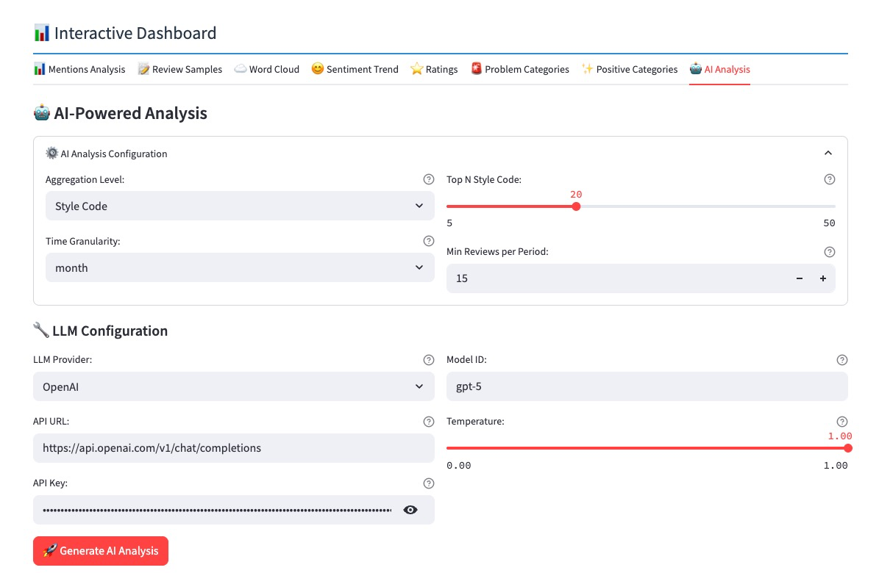
Analytic Panels: AI Analysis of Trends
This panel allows the user to configure the AI analysis of the trends in the data
The first section allows the user to choose the level of analysis (Gender, Style, Class, Sub-Class, End Use), the time granularity (week or month), a threshold for the number of reviews required in the granularity period to qualify for analysis.
The LLM configuration allows a choice of LLM to do the analysis.

Slide 17
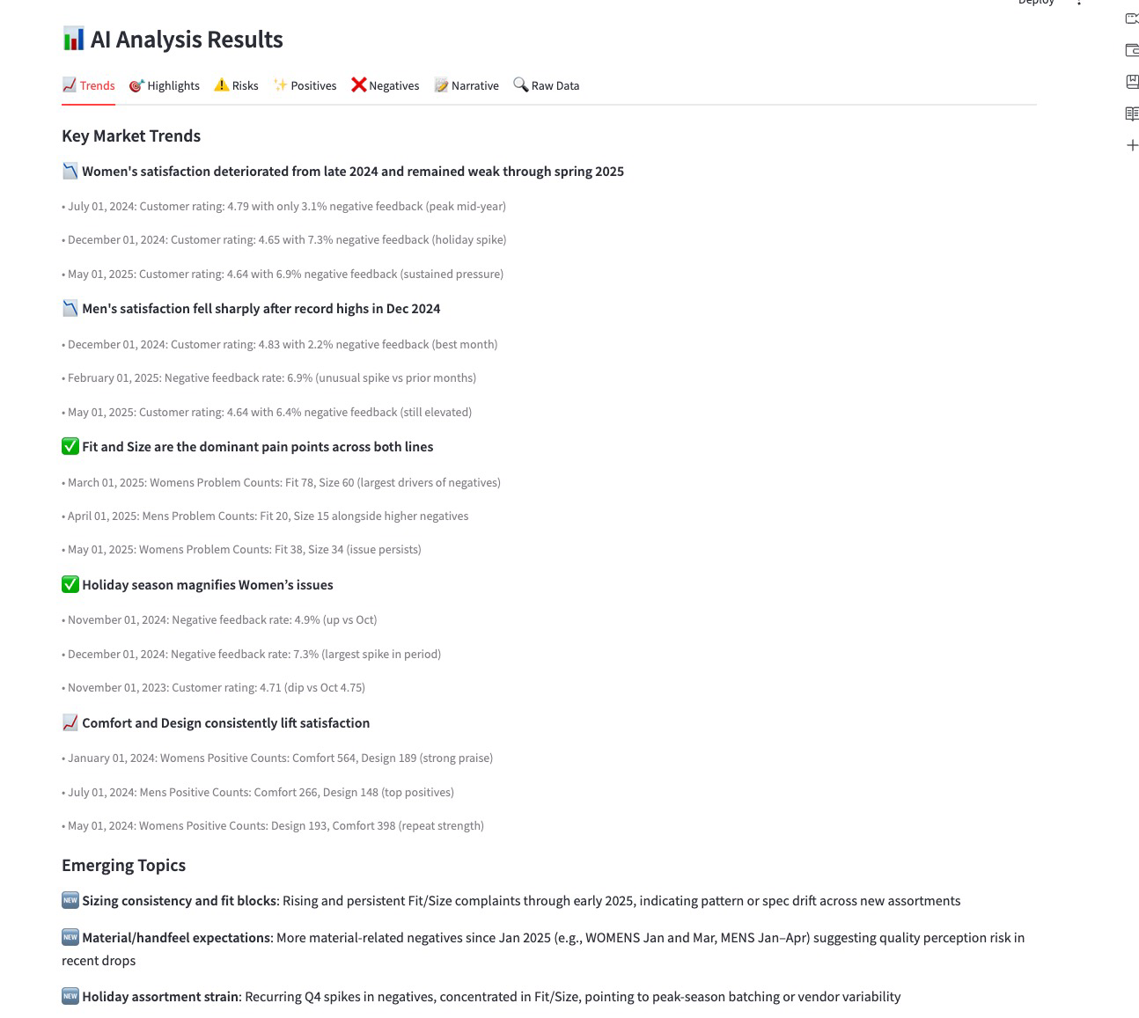
AI Analysis Panels: Trends
This panel shows the key trends that the LLM picked up from that data submitted
In this example Gender was the level chosen, so the focus is on comparing trends within MENS and WOMENS products

Slide 18
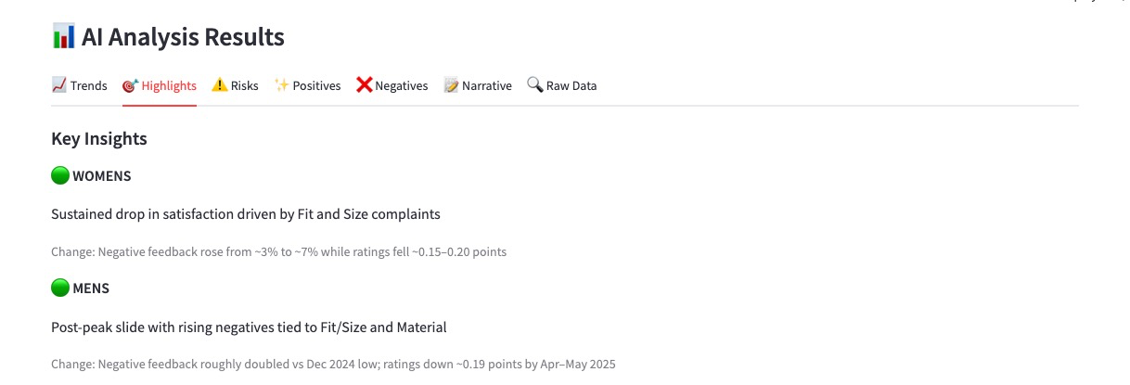
AI Analysis Panels: Highlights
This panel shows any insights that the LLM has determined should be highlighted
In this example Gender was the level chosen, so the focus is on comparing trends within MENS and WOMENS products

Slide 19
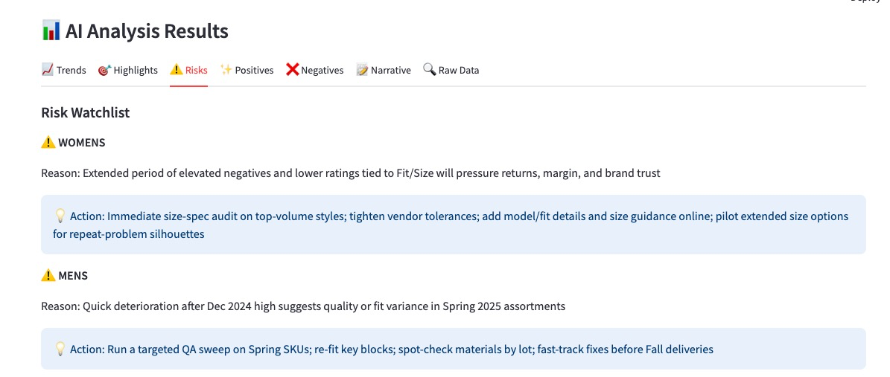
AI Analysis Panels: Risks
This panel shows any risks that the LLM has determined should be highlighted
Suggested ”actions” are recommended. THIS AREA IS PRETTY SPECULATIVE AND NEEDS SOME QA
In this example Gender was the level chosen, so the focus is on comparing trends within MENS and WOMENS products

Slide 20
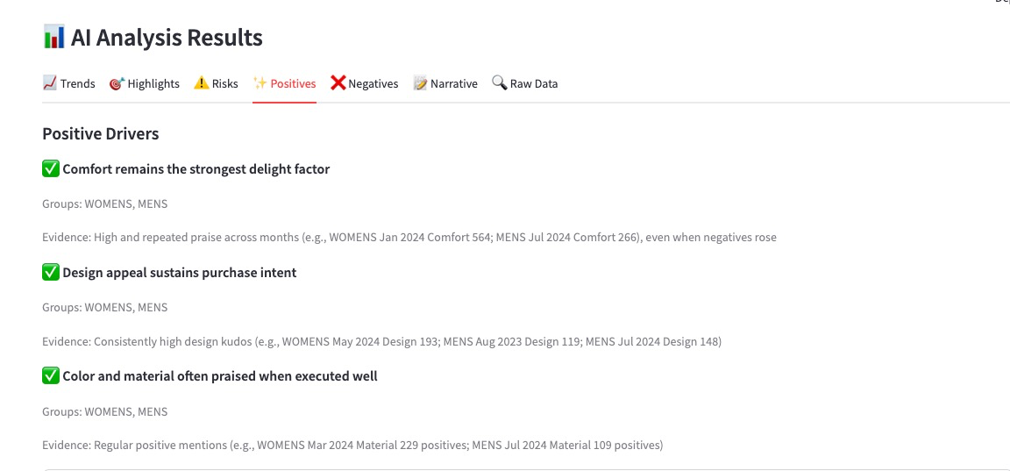
AI Analysis Panels: Positives
This panel shows Positive “Drivers” that the LLM has determined should be highlighted
Evidence is offered in support of each Driver
In this example Gender was the level chosen, so the focus is on comparing trends within MENS and WOMENS products

Slide 21
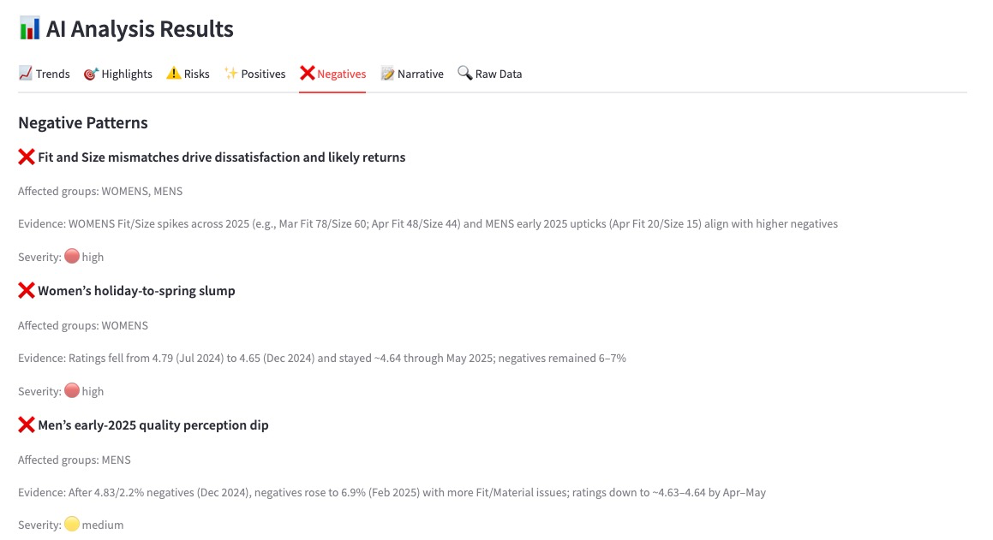
AI Analysis Panels: Negatives
This panel shows Negative “Patterns” that the LLM has determined should be highlighted
Evidence is offered in support of each Pattern
In this example Gender was the level chosen, so the focus is on comparing trends within MENS and WOMENS products

Slide 22
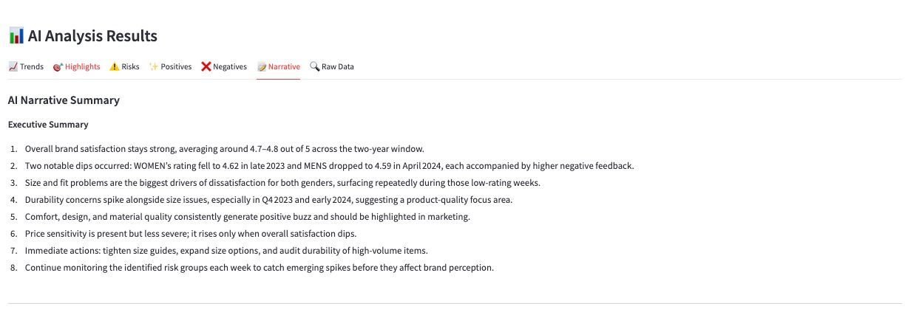
AI Analysis Panels: Narrative
This panel shows a Narrative / Executive summary including items that the LLM has determined should be highlighted
In this example Gender was the level chosen, so the focus is on comparing trends within MENS and WOMENS products

Slide 23
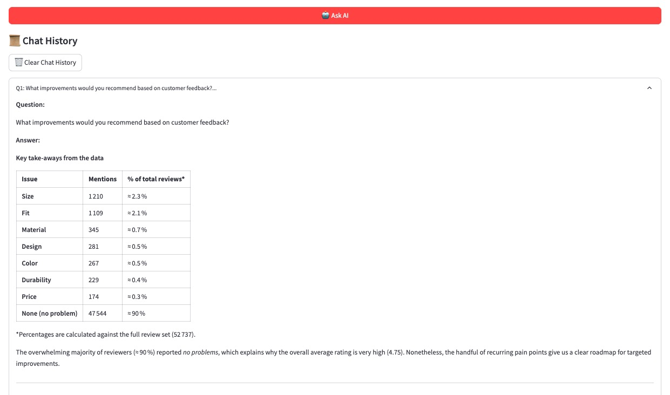






AI Analysis Panels: Data Chatbot
This panel shows the Data chatbot responding to a question from the user.
Click on the slide images below to see all analytical sections

Slide 24
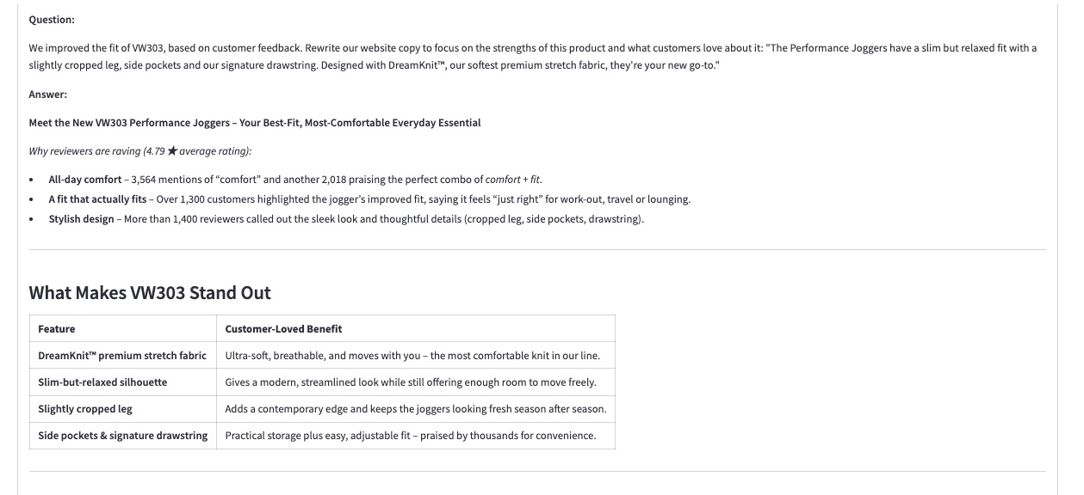
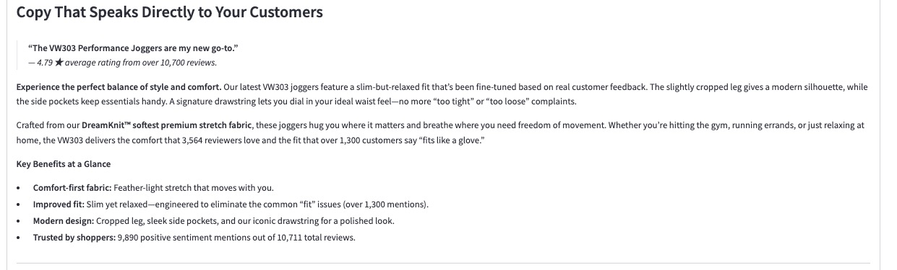
AI Data Chatbot: Chat with the Data – 2nd example
This panel shows the AI Chatbot, tuned to discuss the review data.
In this example the data was aggregated at the Style Code level, and we asked the chatbot how to adjust our website copy assuming a tweak to the style to improve fit.

Slide 25
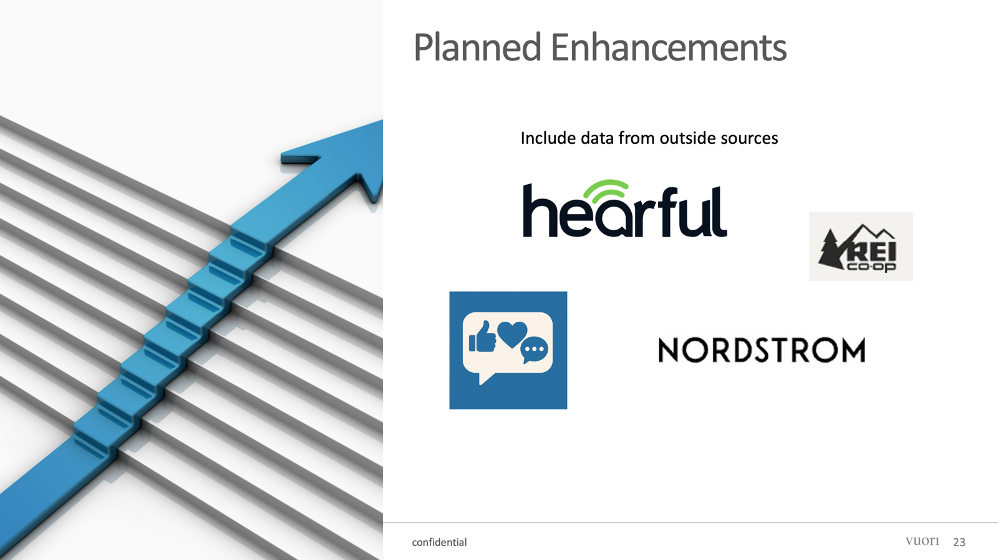
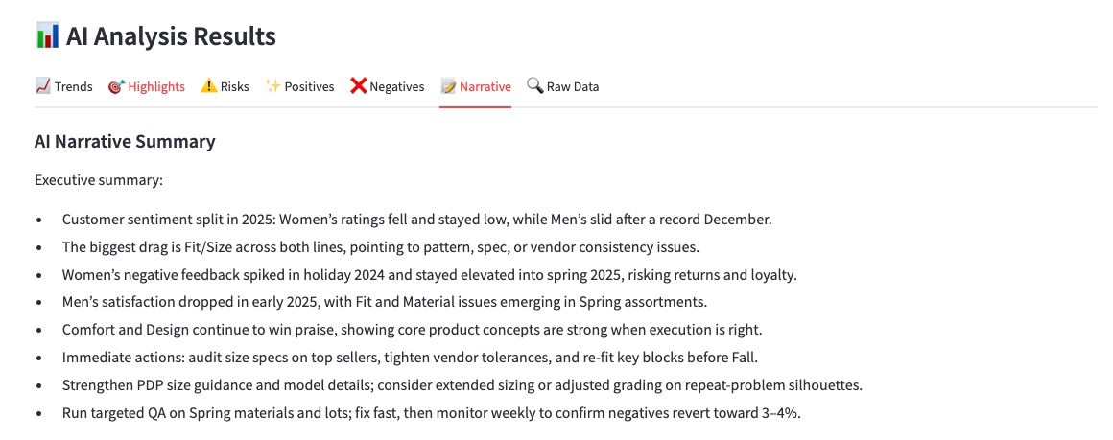
AI Analysis Panels: Narrative
This panel shows an AI generated narrative summary of the overall findings
In this example Gender was the level chosen, so the focus is on comparing trends within MENS and WOMENS products

Slide 26
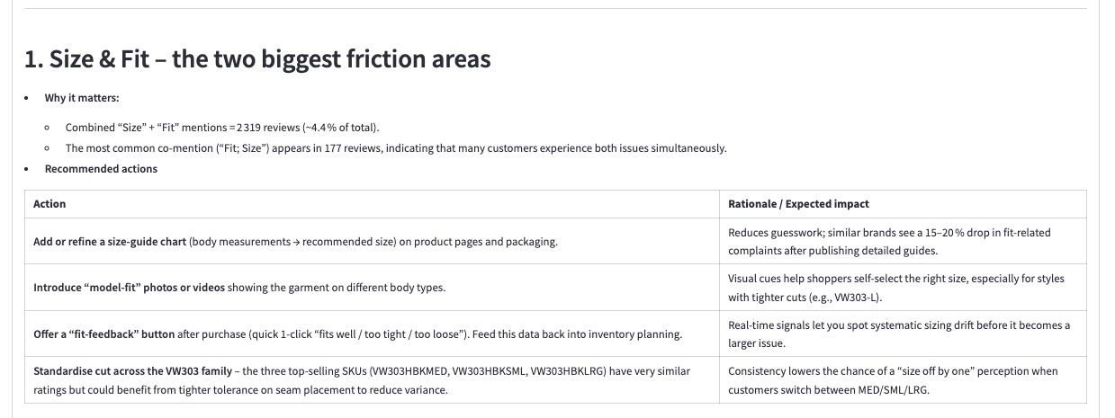
AI Chatbot – Section 1

Slide 27
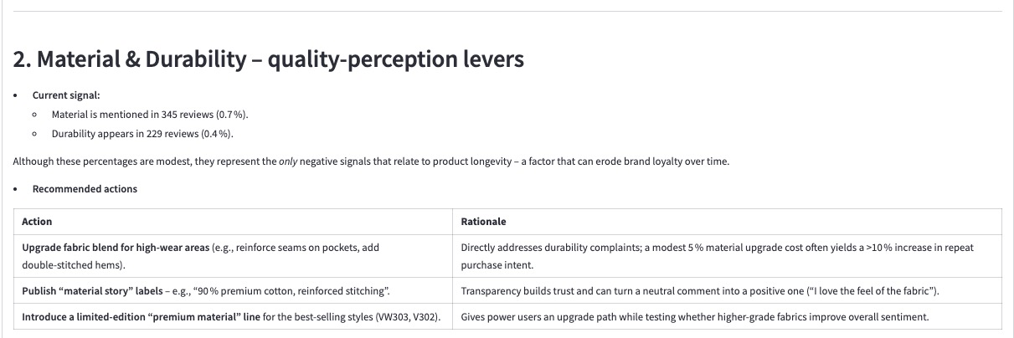
AI Chatbot – Section 2

Slide 28
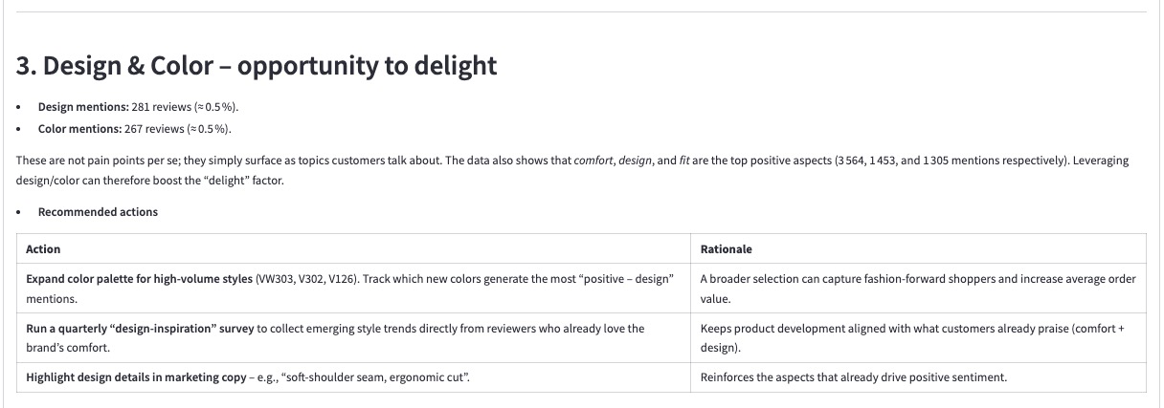
AI Chatbot – Section 3

Slide 29
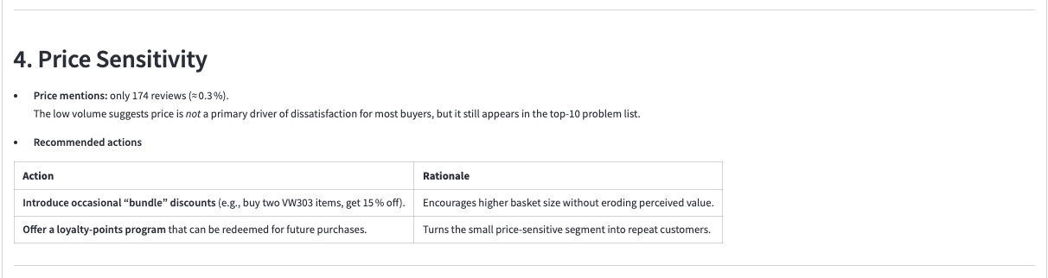
AI Chatbot – Section 4

Slide 30
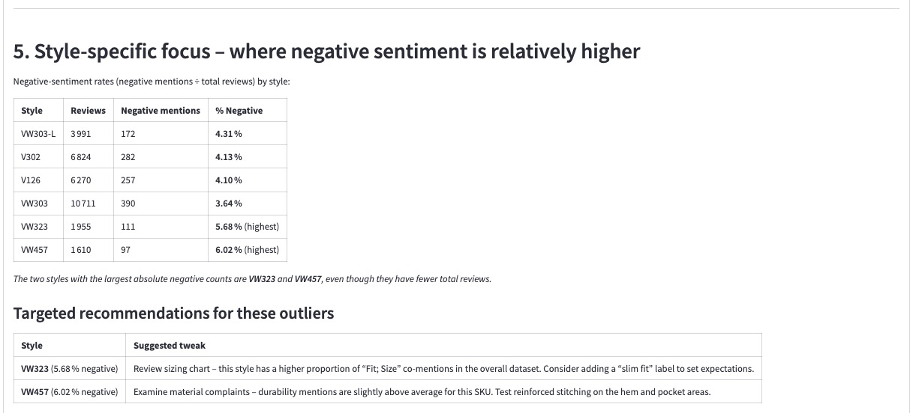
AI Chatbot – Section 5

Slide 31
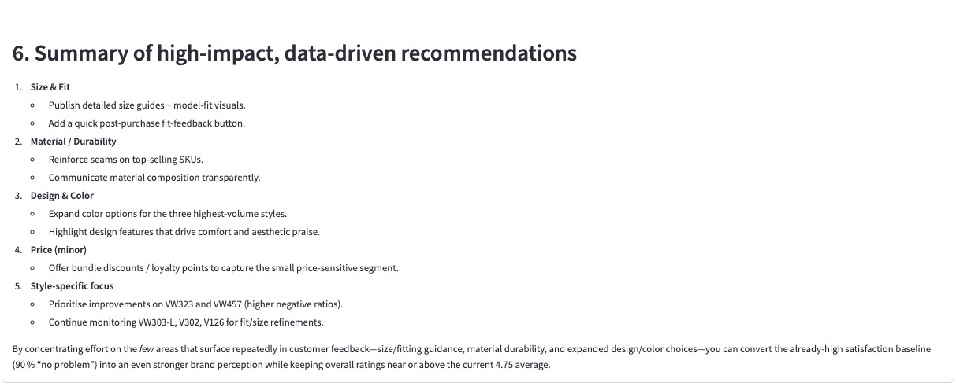
AI Chatbot – Section 6

